Slide 1
Unit 8
Is there a post office near here?
Section B 1a-1e
七年级(下)

Slide 2

Objectives
To learn to ask for directions on the street
To learn to give directions on the street using prepositions of place

Slide 3
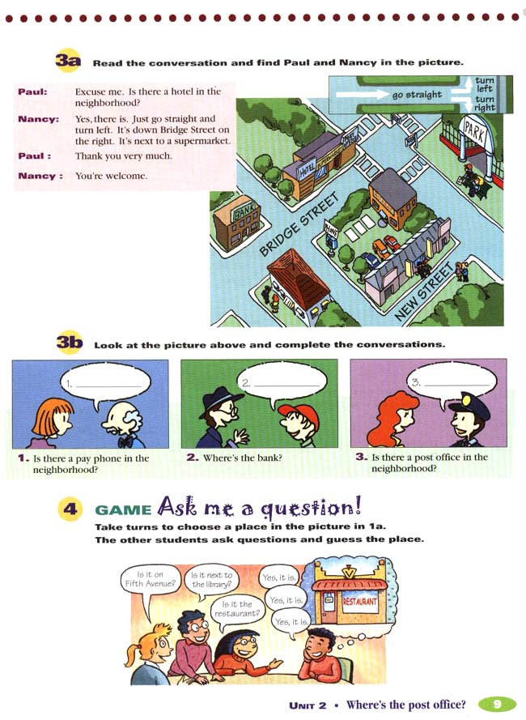
Warming up
Read and find Paul
and Nancy in the picture.
Paul: Excuse me. Is there
a hotel in the
neighborhood?
Nancy: Yes, there is. Just go straight and turn
left. It’s down Bridge Street on the right.
It’s next to a supermarket.
Paul: Thank you very much.
Nancy: You’re welcome.

Slide 4
1. Is there a pay
phone in the
neighborhood?
Yes, there is. Go
straight down
New Street and
turn right. There
is a pay phone
on the right.

Slide 5
2.Where is the bank?
Go straight down New Street and turn right.
Turn left at Bridge Street. The bank is across
from the street.

Slide 6
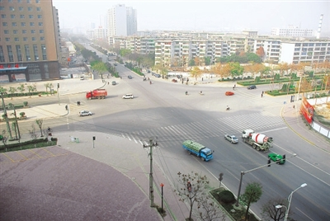

Main words
go along
crossing
turn right
turn left

Slide 7
1a. Match the words in the box with the signs.
a. go along b. turn right c. turn left
1.__________ 2._____________ 3. ___________
a
c
b

Slide 8


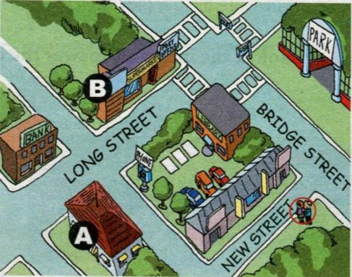
1b. Listen and write the correct place for each
letter in the picture.
A ________________
B ________________
restaurant
hotel

Slide 9
1c. Listen again. Fill in the blanks.
A: Excuse me. Is there a _______ around
here?
B: Yes, there is. Just go _______ Bridge
Street and turn _______ when you see
the library. Go along Long Street and
it’s on the _______. It’s _______ ______
the supermarket and across from the
_______.
hotel
along
left
right
next to
bank

Slide 10
A: Thanks! And is there a restaurant near
the _______?
B: Yes. _______ along New Street. _______
right at the first crossing and the
restaurant is on your left, _____ _____
the pay phone.
A: Thank you very much.
B: You’re welcome.
hotel
Go
Turn
across from

Slide 11
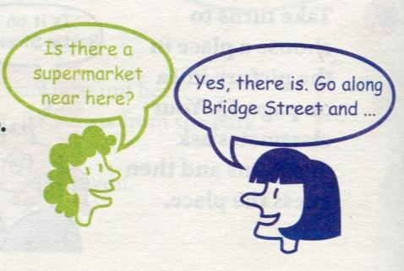
1d. Imagine you and your partner are two
people in the picture in 1b. Ask and
answer about places.
A: Is there a supermarket near here?
B: Yes, there is. Go along Bridge Street
and turn left when you see the library.
A: Got it. I go along Bridge Street
and turn left when I see the library.

Slide 12
Language points
1. turn right/left 意为“向右/左拐”；在这里
right和left都是副词，意为“向右；向左”。
e.g. 向左拐，你会找到那家宾馆。
Turn left and you can find that hotel.
2. go along/down … “沿着……走”, down和
along都是介词用法。
e.g. 沿着新街走，公园就在右边。
Walk along/down New Street and the
park is on the right.

Slide 13
3. on the right/left 意为“在右面/在左面”
on one’s right/left 意为“在某人的右面/左面”
e.g. 在右面有一家银行。
There is a bank on the right.
沿着这条路走，图书馆就在你的左面。
Walk down this road and the library is
on your left.
4. at the first crossing 在第一个十字路口
e.g. 在第二个十字路口向右拐。
Turn right at the second crossing.

Slide 14
Asking for directions
Translation
1. 请问，去车站怎么走？
Excuse me. Could/ Can you tell me the way to the station?
2. 请问，去警察局怎么走？
Excuse me. Which is the way to the police station?

Slide 15
3. 请问，去动物园我该走哪条路？
Excuse me. Which way shall I take to the zoo?
4. 劳驾，最近的邮局在哪儿？
Excuse me. Where is the nearest post office?

Slide 16
5. 请问，你能帮我找到那家水果店吗？
Excuse me. Could/Can you help me find the fruit shop?
6.劳驾，往第十四中学怎么走？
Excuse me. How can I get to No.14 Middle School?

Slide 17
7. 劳驾，附近有医院吗？
Excuse me. Is there a hospital near here?
8. 劳驾，去书店怎么走？
Excuse me. Could/Can you tell me how to get to the bookshop?
= Excuse me. Could/Can you tell me how I can get to the bookshop?

Slide 18
小结
Asking the Way
Is there a…near here?
Where is the nearest…?
Can you tell me how I can get to the…?
Can you tell me how to get to the…?
Could you tell me the way to the…, please?
Which is the way to…?
Do you know the way to…?
Excuse
me.

Slide 19
Showing the Way
Go down/along this street. / Walk along this road.
Take the first turning on the right. /
Turn left at the first turning.
It’s on your right/left. / It’s next to …/across from…
It’ll only take you about 10 minutes if you walk there.

Slide 20
Exercise
选词填空。
enjoy, free, spend, easily, money, sunshine
I want to buy a pen. Give me some _____,
mom?
2. Alice always ______ an hour playing the guitar.
3. It’s sunny today. The _______ is really nice.
money
spends
sunshine

Slide 21
enjoy, free, spend, easily, money, sunshine
4. They found the post office ______.
5. Grace ______ playing computer games very much.
6. Please have some fruit. It’s _____.
easily
enjoys
free

Slide 22
Homework
1. Put the sentences into English.
1) 邮局在哪里？在超市旁边。
2) 这附近有图书馆吗？有, 在第五大街上。
3) 银行在哪里？在旅馆和电子游戏中心。
4) 附近有公园吗？有, 在学校对面。
5) 电话亭在哪里？在邮局旁边。
2. Write a tour guide for your neighborhood.

Slide 23
Thank You!

